Slide 1

ITEC 493: IT Security for Managers
Application and Networking-based Attacks
Elie Kfoury, Ph.D.
Integrated Information Technology Department
College of Engineering and Computing
University of South Carolina
Fall 2023

Slide 2
Module Objectives
By the end of this module, you should be able to:
1. Define the cloud and explain how it is used and managed
2. Explain virtualization
3. Describe cloud and virtualization security controls
4. List different secure network protocols

Slide 3
Introduction to Cloud Computing
In a hosted services environment, servers, storage, and the supporting networking infrastructure are shared by multiple enterprises over a remote network connection
Cloud computing is a model for enabling convenient, on-demand network access to a shared pool of configurable computing resources
Entities that offer cloud computing are called cloud service providers
The savings available through cloud computing are due to the following factors:
Elasticity and scalability
Pay-per-use
On demand
Resiliency

Slide 4
Introduction to Cloud Computing
There are four service models in cloud computing:
Software as a Service (SaaS)
Vendor provides access to the vendor’s software applications running on a cloud infrastructure
Platform as a Service (PaaS)
Consumers install and run their own specialized applications on the cloud computing network
Infrastructure as a Service (IaaS)
Vendor allows customers to deploy and run their own software, including OSs and applications
Anything as a Service (XaaS)
A broad category of subscription services related to cloud computing

Slide 5
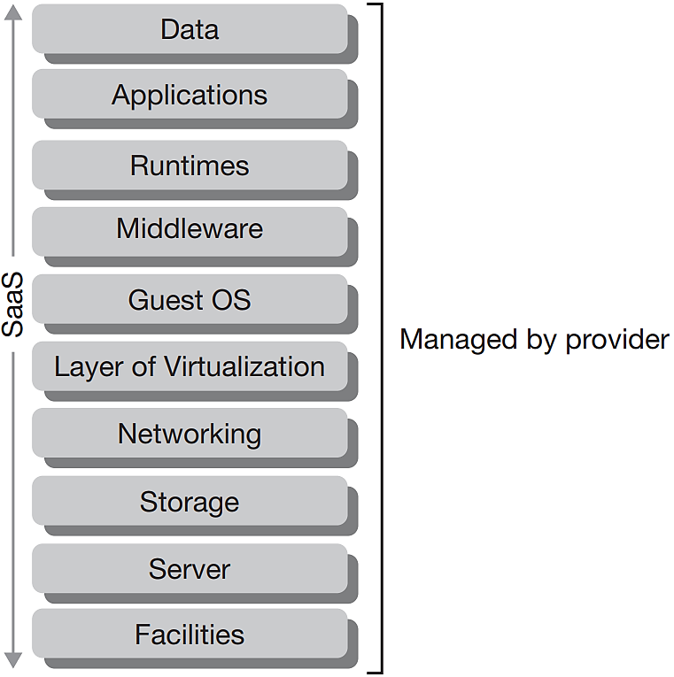
Software-as-a-Service
Applications are supplied by the service provider
The user does not manage or control the underlying cloud infrastructure or individual application capabilities
Examples:
GoogleApps, Microsoft Office 365
Customer Relationship Management (CRM)
Enterprise Resource Planning (ERP)
Etc.

Slide 6
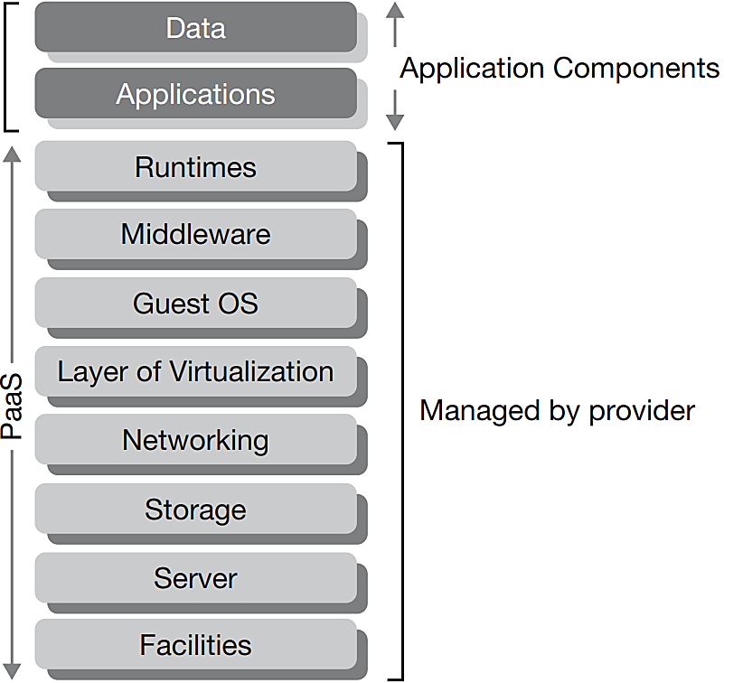
Platform-as-a-Service (PaaS)
PaaS provides an environment for developers and companies to create, host and deploy applications
Saves developers from the complexities of infrastructure
Focus on writing code rather than provisioning services and infrastructure
Not particularly useful when
The application must be portable.
Proprietary programming languages are used.
The hardware and software must be customized to improve the performance of the application

Slide 7
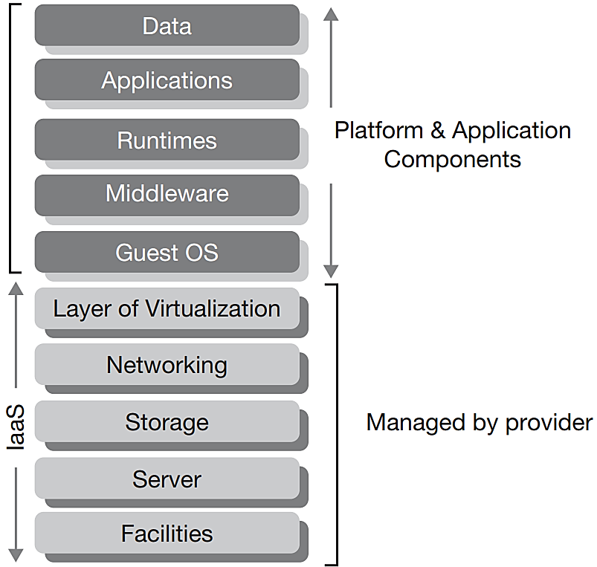
Infrastructure-as-a-Service (IaaS)
The user does not manage or control the underlying cloud infrastructure
But has control over operating systems, storage, deployed applications, and possibly limited control of some networking components, e.g., host firewalls
Examples:
Amazon AWS EC2
Google Compute Engine

Slide 8
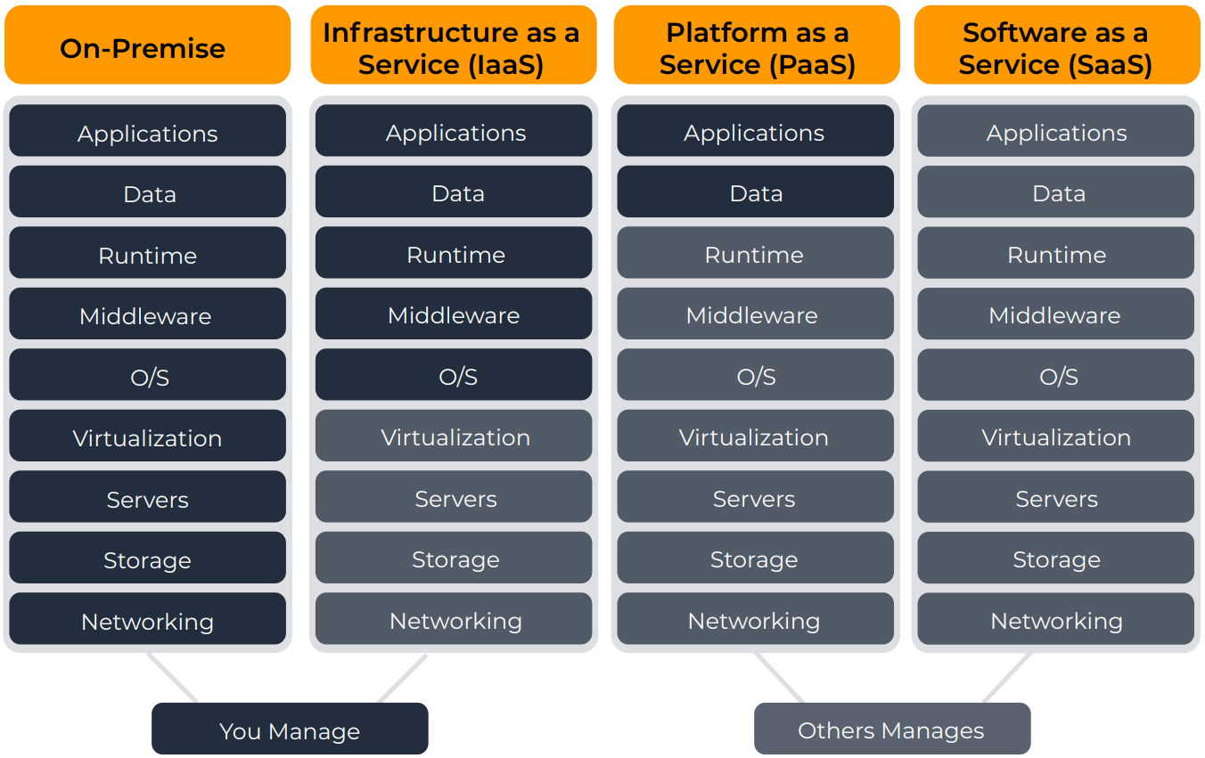
IaaS vs PaaS vs SaaS

Slide 9
Securing Cloud Computing
Security issue | Description
Unauthorized access to data | Improper cloud security configurations can result in data being left exposed.
Lack of visibility | Organizations have limited or no visibility into the security mechanisms of the cloud provider and thus cannot verify the effectiveness of security controls.
Insecure application program interfaces (APIs) | While APIs help cloud customers customize their PaaS by providing data recognition, access, and effective encryption, a vulnerable API can be exploited by threat actors.
Compliance regulations | Maintaining compliance requires that an organization know where its data is, who can access it, and how it is protected, but this can be difficult in an opaque cloud system, which lacks transparency.
System vulnerabilities | A cloud infrastructure is prone to system vulnerabilities due to complex networks and multiple third-party platforms.

Slide 10
Securing Cloud Computing
Cloud Security Controls
Securing cloud computing involves using controls such as the following:
Conducting audits – a cloud security audit is an independent examination of cloud service controls
Use Regions and Zones – reliability and resiliency are achieved through duplicating processes across one or more geographical areas (called high availability across zones)
Secrets management – enables strong security and improved management of a microservices-based architecture, allowing the entire cloud infrastructure to remain flexible and scalable without sacrificing security

Slide 11
Securing Cloud Computing
Application Security
One of an organization’s security protections for cloud computing application security is to use a cloud access security broker (CASB)
CASB is a set of software tools or services that resides between the enterprises’ on-premises infrastructure and the cloud provider’s infrastructure
CASB acts as a “gatekeeper”, ensuring that the security policies of the enterprise extend to its data in the cloud
Security Virtual Device Solutions
A next-generation secure web gateway (SWG) examines both incoming and outgoing traffic and performs basic URL and monitoring in web applications
A cloud firewall is virtual software that functions in a similar manner to a physical security appliance by examining traffic into and out of the cloud

Slide 12
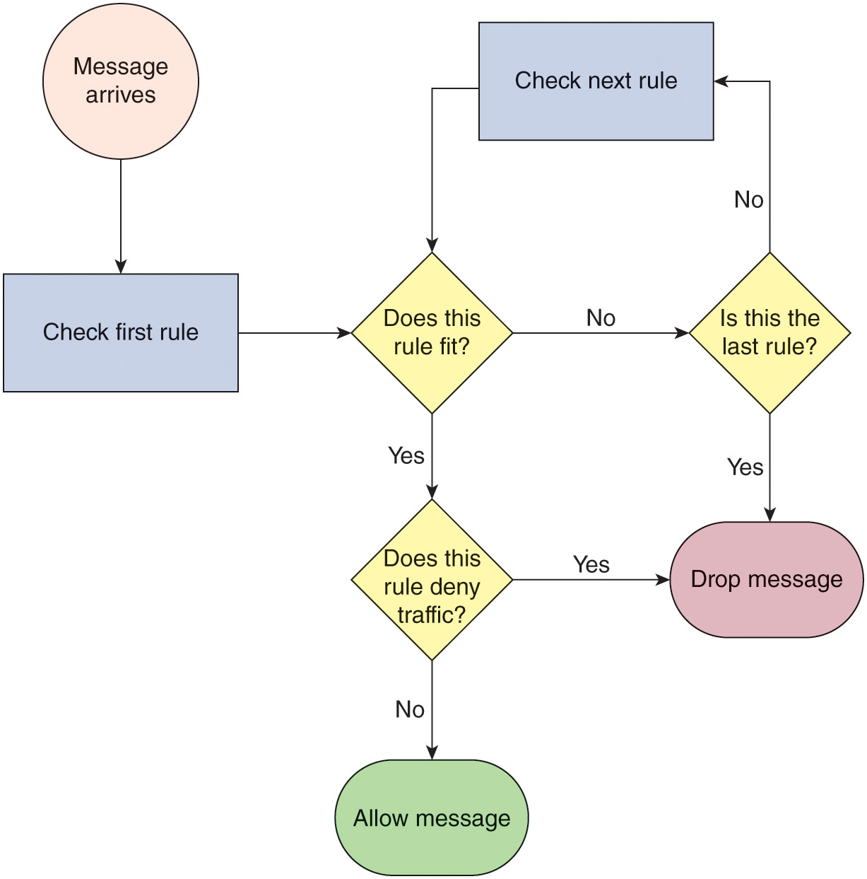
Virtual Network Security
Figure 6-3 Firewall rules are checked in order of priority to determine whether a message is allowed to pass.
Notes:
Figure 6-3 shows a diagram of how the firewall rule checking process plays out.

Slide 13






Security groups
AWS Cloud
Region
Availability Zone
VPC: 10.0.0.0/16
Public subnet:10.0.1.0/24
Security group
Security groups act at the instance level.
Private subnet: 10.0.2.0/24
Security group
Notes:
Self-explanatory

Slide 14
Security groups
Security groups have rules that control inbound and outbound instance traffic.
Default security groups deny all inbound traffic and allow all outbound traffic.
Security groups are stateful.
Inbound
Source | Protocol | Port Range | Description
sg-xxxxxxxx | All | All | Allow inbound traffic from network interfaces assigned to the same security group.
Outbound
Destination | Protocol | Port Range | Description
0.0.0.0/0 | All | All | Allow all outbound IPv4 traffic.
::/0 | All | All | Allow all outbound IPv6 traffic.
Notes:
Self-explanatory

Slide 15
Custom security group examples
You can specify allow rules, but not deny rules.
All rules are evaluated before the decision to allow traffic.
Inbound
Source | Protocol | Port Range | Description
0.0.0.0/0 | TCP | 80 | Allow inbound HTTP access from all IPv4 addresses
0.0.0.0/0 | TCP | 443 | Allow inbound HTTPS access from all IPv4 addresses
Your network's public IPv4 address range | TCP | 22 | Allow inbound SSH access to Linux instances from IPv4 IP addresses in your network (over the internet gateway)
Outbound
Destination | Protocol | Port Range | Description
The ID of the security group for your Microsoft SQL Server database servers | TCP | 1433 | Allow outbound Microsoft SQL Server access to instances in the specified security group
Notes:
Self-explanatory

Slide 16
Securing Cloud Computing
Lack of a Cloud Conceptual Model
Physical networks use the Open Source Interconnection (OSI) seven-layer model to illustrate network functionality
The lack of a conceptual model like the OSI model makes selecting and managing security virtual devices more challenging
Different cloud-based conceptual models are starting to be proposed
However, no single model has been widely adapted
One model is shown in the next slide

Slide 17
Securing Cloud Computing
Layer and name | Description | Party responsible
5—Application Experience | End-user facing interface | Customer
4—Native Service | Create, store, process | Customer
3—Software-Defined Datacenter | Create infrastructure | SaaS—Cloud computing provider PaaS and IaaS—Customer
2—Virtualization Software | Software that virtualizes the hardware | Cloud computing provider
1—Physical Infrastructure | Buildings, power, cables, hardware, utilities | Cloud computing provider

Slide 18
Defining Virtualization
What is Virtualization?
Virtualization is a means of managing and presenting computer resources without regard to physical layout or location
Host virtualization is a type of virtualization in which an entire operating system environment is simulated
A virtual machine (VM) is a simulated software-based emulation of a computer
The host system runs a hypervisor that manages the virtual operating systems and supports one or more guest systems
Virtualization is used to consolidate multiple physical servers into VMs that can run on a single physical computer

Slide 19
Defining Virtualization
The VM monitor program is called a hypervisor, which manages the VM operating systems
Two types of hypervisor:
Type I – run directly on the computer’s hardware instead of the underlying OS
Type II – run on the host OS, much like an application
A container holds only the necessary OS components that are needed for that specific application to run
Reduces the necessary hard drive storage space and RAM needed
Allows for containers to start more quickly because the OS does not have to be started

Slide 20
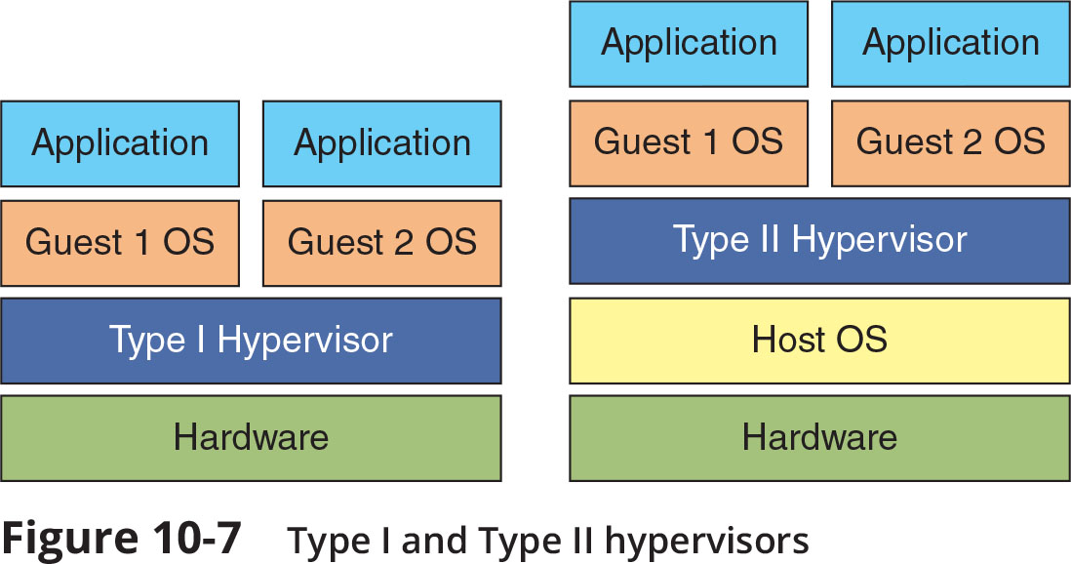
Defining Virtualization
Figure 10-7 Type I and Type II hypervisors

Slide 21
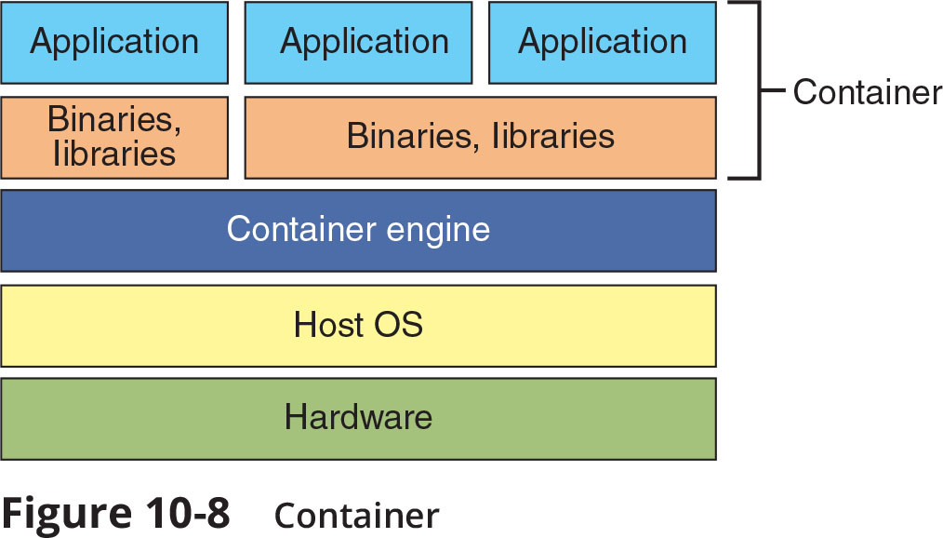
Defining Virtualization
Figure 10-8 Container

Slide 22
Defining Virtualization
Advantages of Virtualization
New virtual server machines can be made available (host availability) and resources can easily be expanded or contracted as needed (host elasticity)
Can reduce costs
Fewer physical computers must be purchased and maintained
Can provide uninterrupted server access to users
Supports live migration which allows a virtual machine to be moved to a different physical computer with no impact to users

Slide 23
Infrastructure as Code
Software-defined network (SDN)
An SDN virtualizes parts of the physical network so that it can be more quickly and easily reconfigured
This is accomplished by separating the control plane from the data plane
If traffic needs to flow through the network:
It receives permission from the SDN controller, which verifies the communication is permitted by the network policy of the enterprise
Once approved, the SDN controller computes a route for the flow to take and adds an entry for that flow in each of the switches along the path

Slide 24
Infrastructure as Code
Software-Defined Visibility (SDV)
Software-defined visibility (SDV) is a framework that allows users to create programs in which critical security functions can be automated
SDV allows network administrators to automate multiple functions in a network infrastructure including:
Dynamic response to detected threat patterns
Adjustments to traffic mode configurations for in-line security tools
Additional IT operations-management functions and capabilities

Slide 25
Security Concerns for Virtual Environments
Security-related advantages of virtualization:
Test latest security updates by downloading on a virtual machine before installing on production computers
A snapshot of a particular state of a virtual machine can be saved for later use
Testing the existing security configuration (security control testing) can be performed using a simulated network environment
VMs can promote security segregation and isolation
A suspicious program can be loaded into an isolated virtual machine and executed (sandboxing)
If the program is malware, only the virtual machine will be impacted

Slide 26
Security Concerns for Virtual Environments
Security concerns for virtualized environments:
Not all hypervisors have the necessary security controls to keep out attackers
Existing security tools were designed for single physical servers
VMs must be protected from both outside networks and other VMs on the same physical computer
VMs may be able to “escape” from the contained environment and directly interact with the host OS
Important to have virtual machine escape protection
Virtual machine sprawl is the widespread proliferation of VMs without proper oversight or management
Combating VM sprawl is called virtual machine sprawl avoidance
Installing a virtual machine manager can help

Slide 27
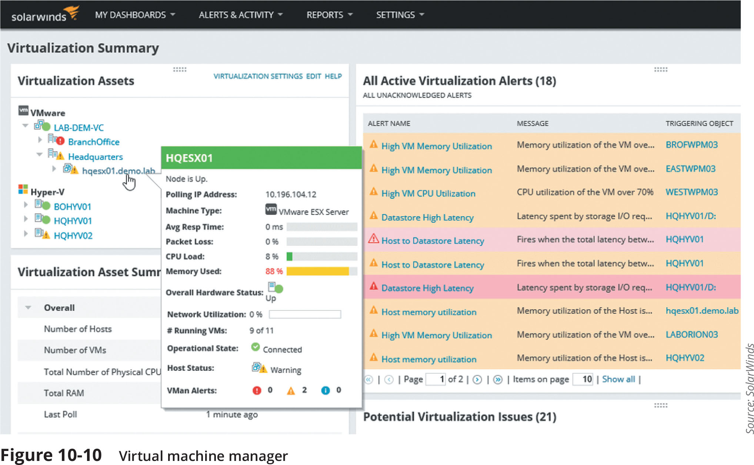
Security Concerns for Virtual Environments
Figure 10-10 Virtual machine manager

Slide 28
Secure Network Protocols
Common secure network protocols include:
Simple Network Management Protocol (SNMP)
Domain Name System (DNS) Security Extensions
File Transfer Protocol
Secure email protocols
Lightweight Directory Access Protocol (LDAP)
Internet Protocol version 6 (IPv6)

Slide 29
Simple Network Management Protocol (SNMP)
SNMP is used to manage network equipment and is supported by most network equipment manufacturers
It allows administrators to remotely monitor, manage, and configure network devices
SNMP functions by exchanging management information between network devices
Each SNMP-managed device has an agent or a service
Listens for and executes commands
Agents are password protected
Password is known as a community string
Security vulnerabilities were present in SMNP versions 1 and 2
Version 3 uses usernames and passwords along with encryption to address vulnerabilities

Slide 30
Domain Name System Security Extensions (DNSSEC)
DNS is often the focus of attacks
DNS poisoning and DNS hijacking are examples
These attacks can be thwarted by using Domain Name System Security Extensions (DNSSEC)
DNSSEC adds additional resource records and message header information which can be used to verify the requested data has not been altered in transmission
Using asymmetric cryptography, a private key that is specific to a zone is used in encrypting a hash of a set of resource records
Which is then used to create the digital signature to be stored in the resource record

Slide 31
File Transfer Protocol
File transfer protocol (FTP) is an unsecure protocol used to connect to an FTP server in order to transfer files
Methods for using FTP on local host computer
Using an FTP client
From a command prompt
Using a web browser
FTP vulnerabilities include:
FTP does not use encryption
Files transferred using FTP are vulnerable to man-in-the-middle attacks

Slide 32
File Transfer Protocol
There are two options for secure transmissions over FTP
FTP Secure (FTPS) uses SSL or TLS to encrypt commands sent over the control port (port 21)
The data port (port 20) may not be encrypted
Secure FTP (SFTP)
Uses only a single TCP port instead of two ports
All data and commands are encrypted

Slide 33
Secure Email Protocols
Earlier email systems use two TCP/IP protocols to send and receive messages:
Simple Mail Transfer Protocol (SMTP) and Post Office Protocol (POP)
IMAP (Internet Mail Access Protocol) is a more recent and advanced email system
As a means of security, a mail gateway monitors emails for unwanted content and prevents these messages from being delivered
A mail gateway can automatically and transparently encrypt outbound email messages

Slide 34
Lightweight Directory Access Protocol (LDAP)
A directory service is a database stored on the network that contains information about users and network devices
The directory service also keeps track of all the resources on the network and a user’s privileges to those resources and grants or denies access based on the directory service information
Lightweight Directory Access Protocol (LDAP) makes it possible for almost any application running on any computer platform to obtain directory information
A weakness of LDAP is that it can be subject to LDAP injection attacks
This may allow an attacker to construct LDAP statements based on user input statements
The defense against LDAP injection attacks is to examine all user input before processing

Slide 35
Internet Protocol Version 6 (IPv6)
IPv6 addresses weaknesses of IPv4 and also provides other significant improvements
IPv6 increases the number of available addresses
IPv6 has enhanced security features:
IPv6 can implement end-to-end encryption
This makes man-in-the-middle attacks significantly more difficult
IPv6 supports more secure name resolution
The Secure Neighbor Discovery (SEND) protocol can send cryptographic confirmation that an endpoint is who it claims to be
This makes ARP poisoning more difficult

